Slide 1

Spring Plenary 2026 – Welcome everyone!!

Slide 2

Minutes & Matters Arising

Slide 3

2025 Workplan Review

Slide 4

Governance & Accountability - ✅ Strong foundation in place
MoU signed
Secretariat meetings held
Full policy review completed and set to be ratified
Notes:
2025 Action: Renegotiate the MOU; Set up MoU and get it signed. Which we did on 28 April.
PPN Secretariat Meetings – Action : informing members and encouraging attendance. Reinforcing policies around attendance & conduct. Target: 2nd Tuesday of each month - We intend to hold 9 Secretraiat meeting in a year, we held 7 last year.
Full Policy Review – The target was that it would be ratified and begin after the Spring Plenary, to be presented at the Winter Plenary but became a much larger job of work. We open a consultation period for our members after the 2025 Spring Plenary. This has been completed. Massive Thank You to H. Emerson for her hard work.

Slide 5
Representation & Participation - Attendance remains a challenge ⚠️
3 new Secretariat members appointed
Most SPC and LCDC seats filled
Vacancies are advertised constantly
Representative trainings - all poorly attended.
Notes:
Representative Induction in January, Linkage Group set up in the summer, and Reps training in September all poorly attended - Build strong relationships; Secretariat member assigned to each Linkage Group - We held an induction meeting in January, and a Linkage Groups start up meeting in the summer. We collaborated with SE Regional PPNs in September- each event was very poorly attended.

Slide 6
Linkage Groups👥
late 2025
Recruitment of Linkage Group facilitator late 2025
Oct. 2025
Structured proposal approved October 2025
2026
Work continues into 2026

Slide 7
Training & Capacity Building - 📘 Learning applied
trainings delivered
Attendance dropped during summer months
Learning applied to future scheduling
Notes:
Training Needs Analysis survey went out to the groups in January - Value-for-money training identified - 3 x Social Media Trainings, Strategic Planning for Non-Profits, Democratising Advocacy, Volunteer Management, Reps Induction Training, SE Regional Reps collaborative training. The numbers attending training dropped off significantly in the summer, so we will look to hold trainings outside of the summer months going-forward.

Slide 8
Communication & Engagement - ✅ One of 2025’s key successes
31 newsletters issued
134 mass emails sent
PPN continues as a recognised community voice
Notes:
Funding Roadshows January 2026 – I felt famous. I think I met every one of the 1600 people receiving our emails, and they gave us great feedback. Cork County PPN continues as a recognised community voice - our newsletter goes from strength to strength, and more than more council grants and other organisations now look for PPN numbers as a requirement.

Slide 9
Operations & Systems - ⚠️ Addressed in 2026 planning
Database overhaul delayed due to capacity constraints
Database work commenced January 2026
Notes:
The action: Manage and maintain active register of groups . The target was to do an in-depth review of the database - Maintain list of active and engaged groups - had little capacity to achieve an overhaul of the database in 2025, we did seek to create a Working Group from the Secretraiat to assist with this, but there was no interest. Working commenced on the Database in January 2026 instead.

Slide 10
Plenaries & Member Engagement 📣
May
Spring Plenary held in May
November
Plenary cancelled due to Coordinators illness
Today
Workplan review was set for November Plenary but has now been completed

Slide 11

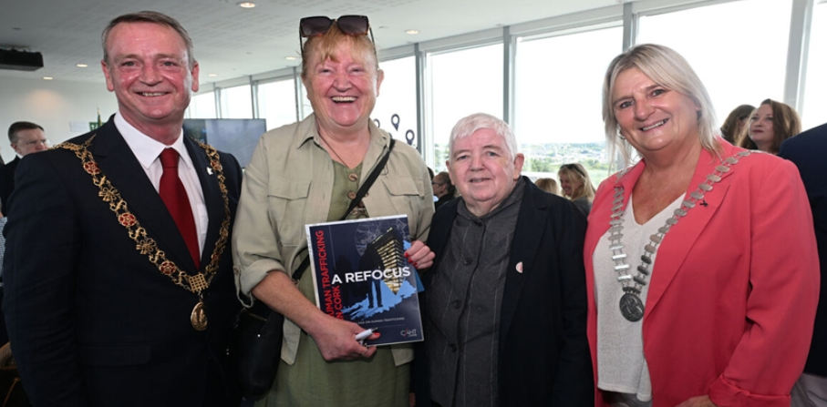

Networking & Advocacy - ✅ Strong external representation
Strong local, regional and national engagement
PPN represented at multiple forums, expos and consultations –
Notes:
Macroom Lions Club Annual Clubs Day
Tidy Towns Showcase in County Hall
Mayor's Community & Voluntary Awards
PPN Retreat (facilitated Workers Meeting)
EAPN (European Anti-Poverty) forum - Social Inclusion Consultation
The Wheel’s Cork Roadshow
The Wheel’s Small Organisation Meet up
UCC/HORIZON_EUROPE WORKSHOP
Ballincollig - Launch of Tidy Towns Comp 2025 - Networking event
Attended Launch - Cork City PPN's Wellbeing Book & Podcast
Spring Plenary
Cork Volunteer Expo
Cork Summer Show
Introduction to Linkage Groups meeting
PPN Emergency Response Meeting, Portlaoise
Cork Against Human Trafficking (CAHT) - World Day against Trafficking in Persons Workshop
Social Inclusion, Community & Rural Development SPC Presentation
CVC Consultation w/ Charities Regulator
Ploughing 2025 - Day 1 (met a lady from Kilnamatrya)
Culture Showcase, 19 September
Building Resilient Communities Conference, Waterford
Waterford C&V Award (NN Judged)

Slide 12

Reporting & Compliance 📊
Financial and activity reports completed, despite a learning curve!

Slide 13
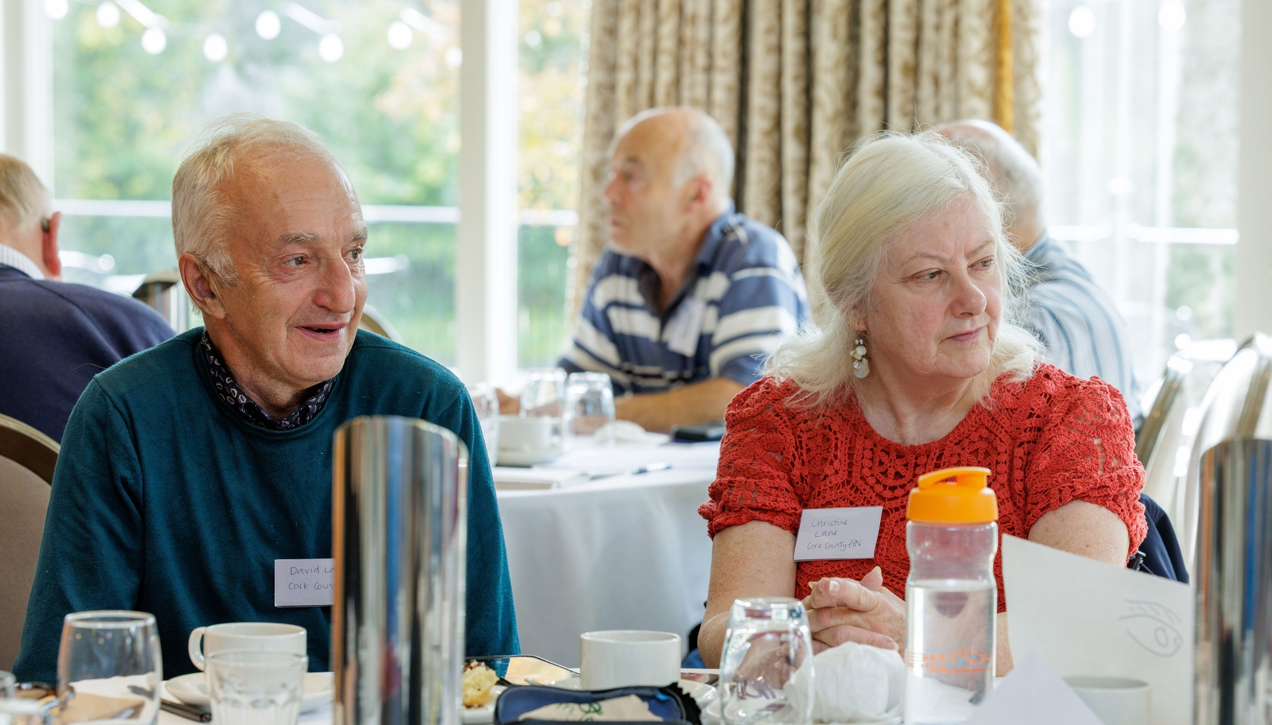
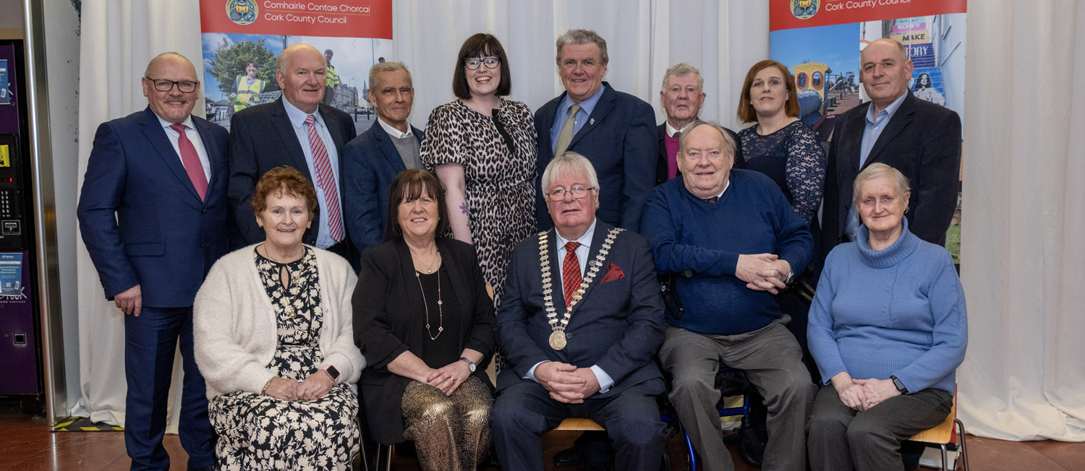
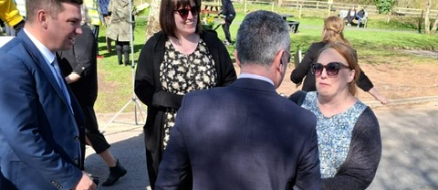
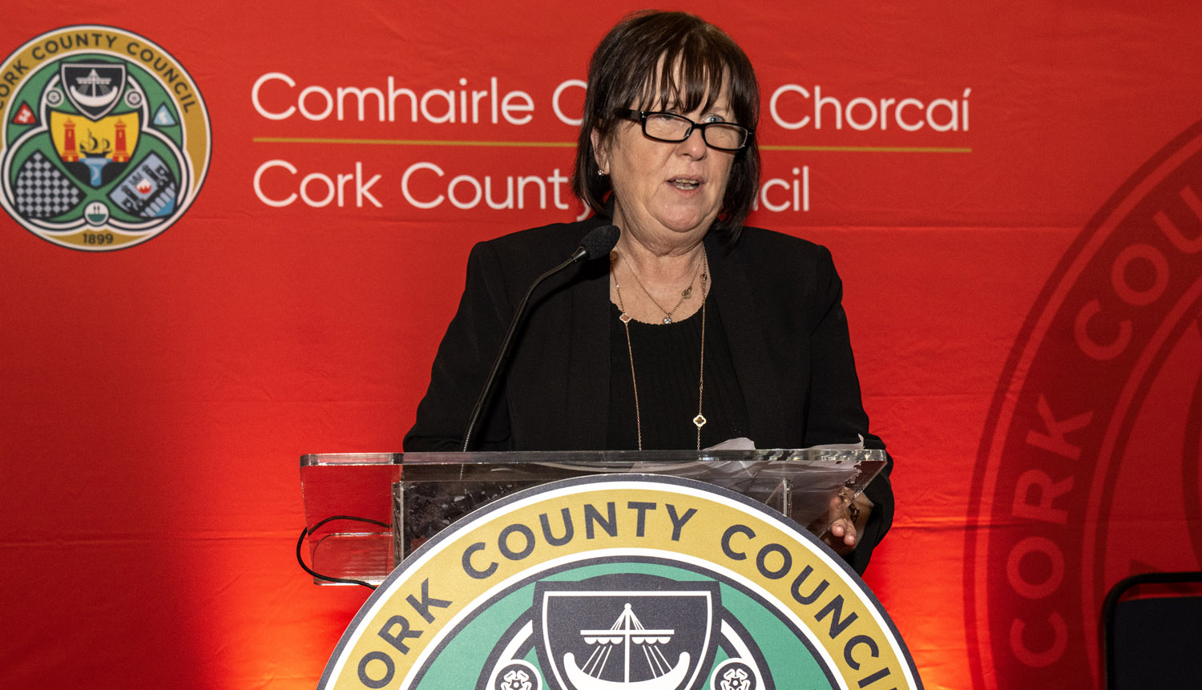

Slide 14
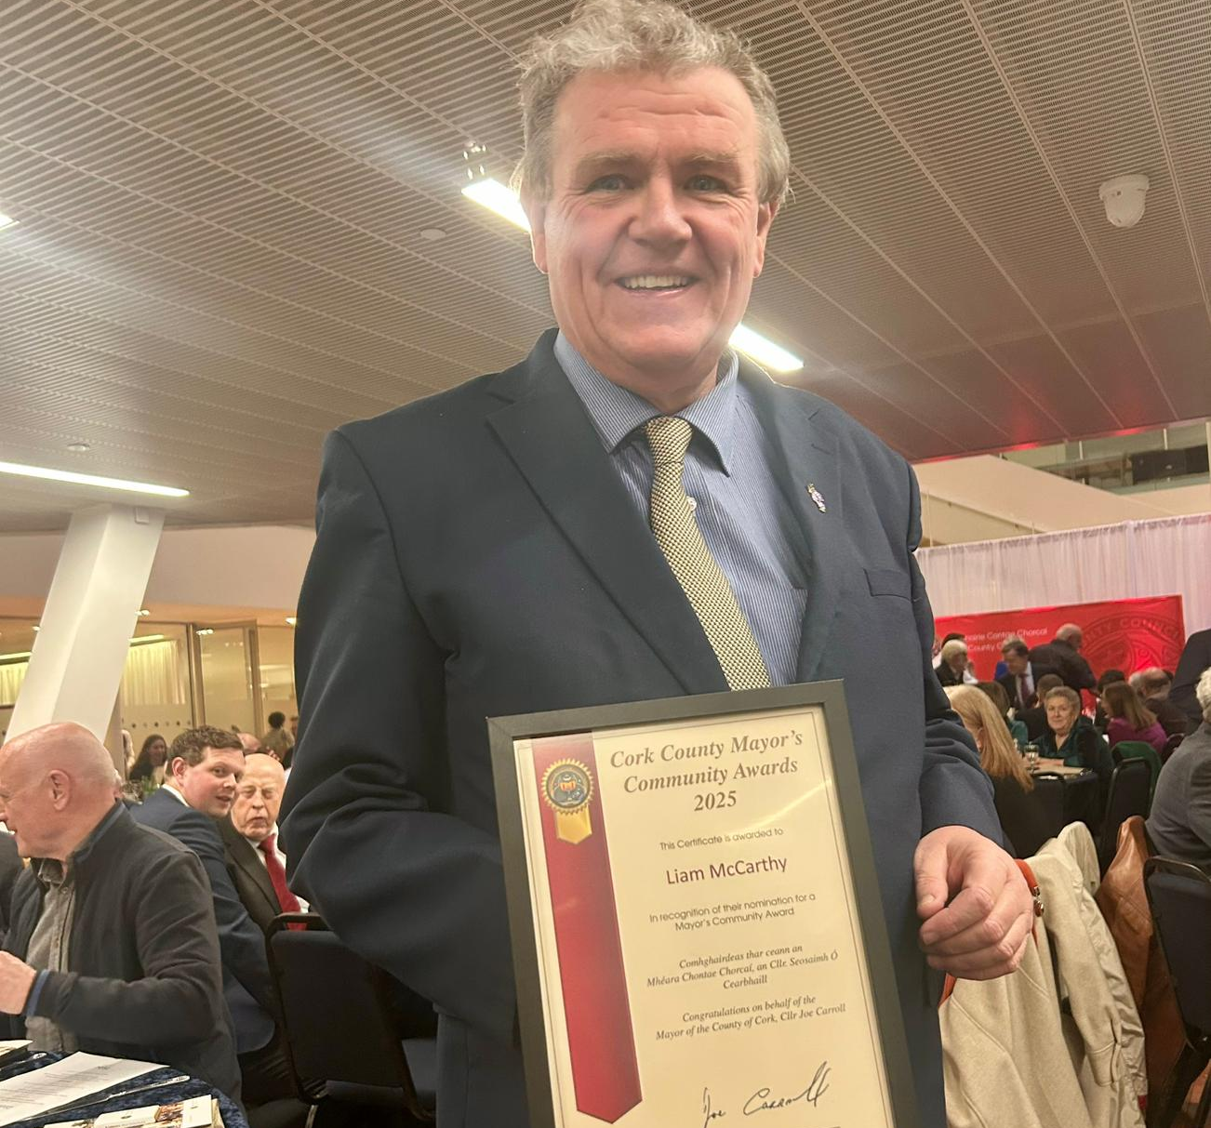
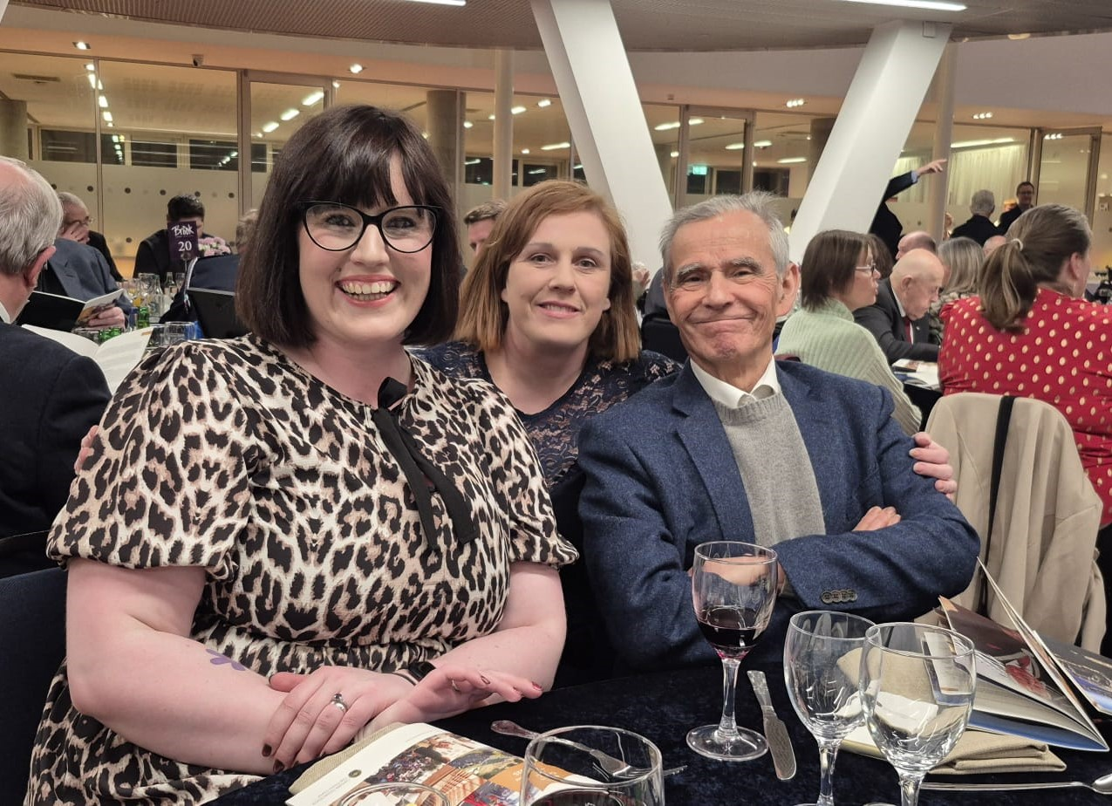
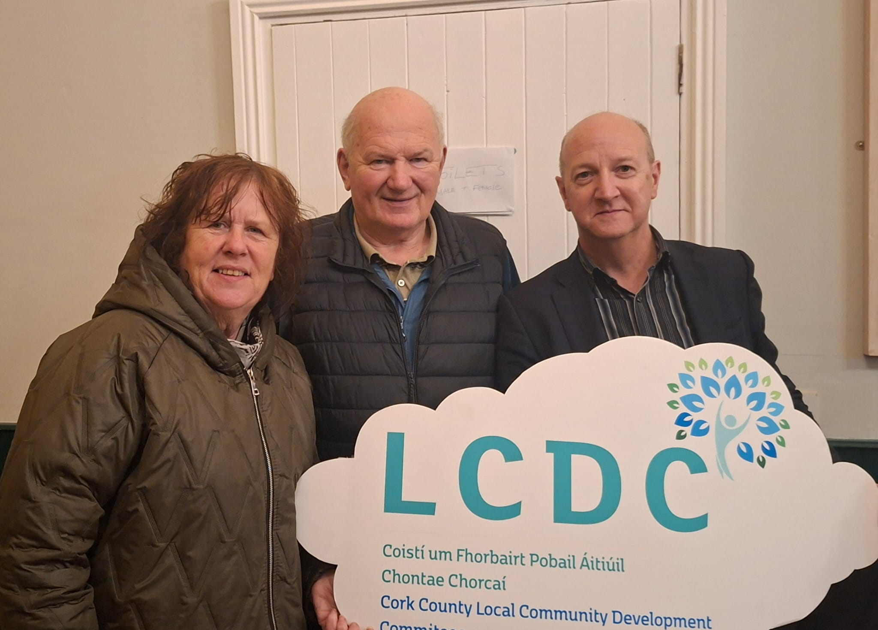

Slide 15
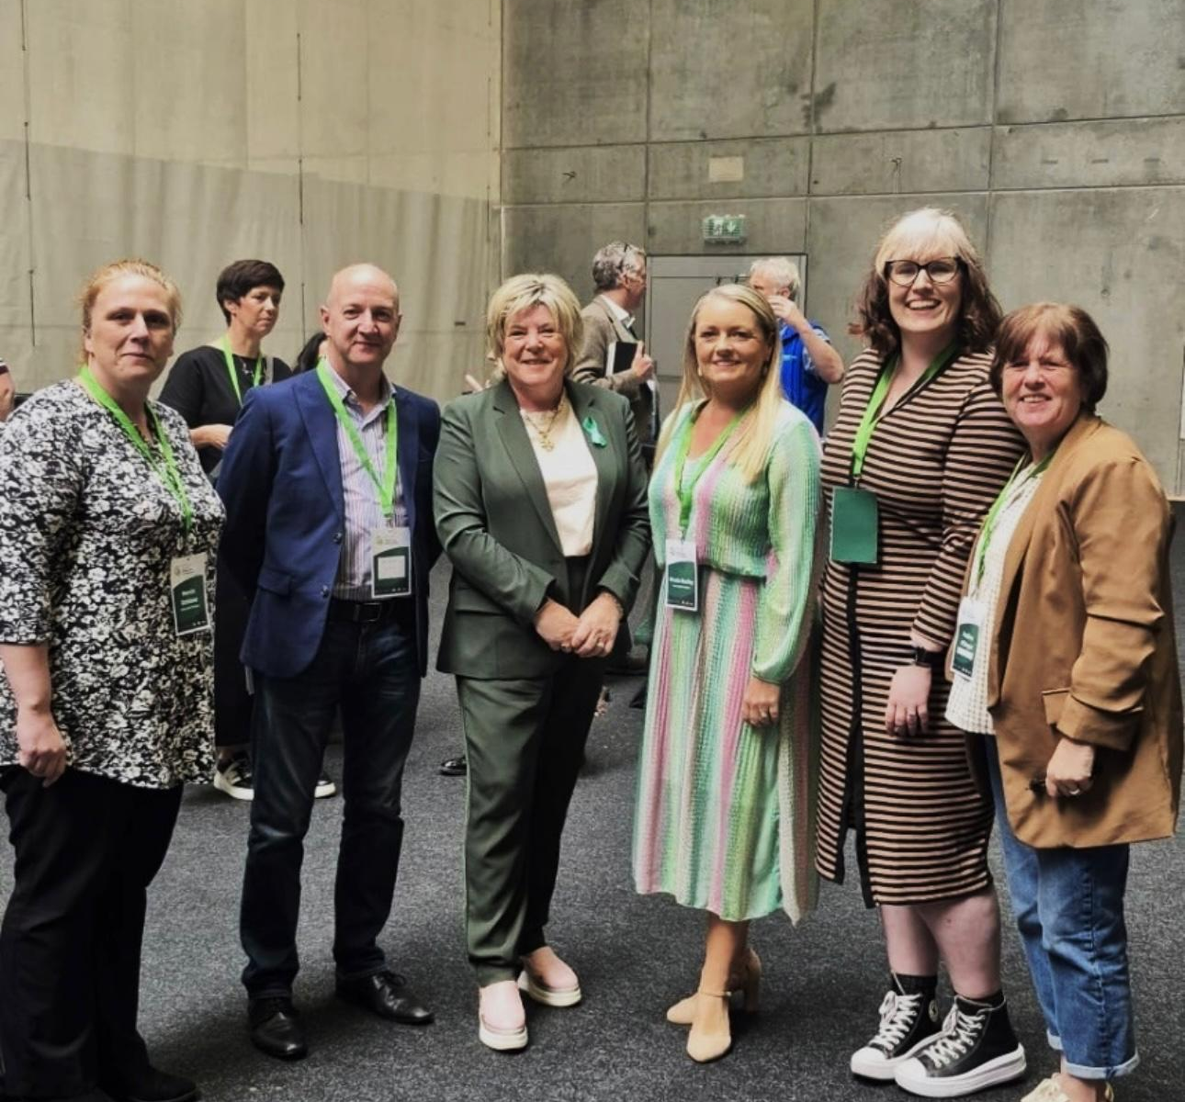
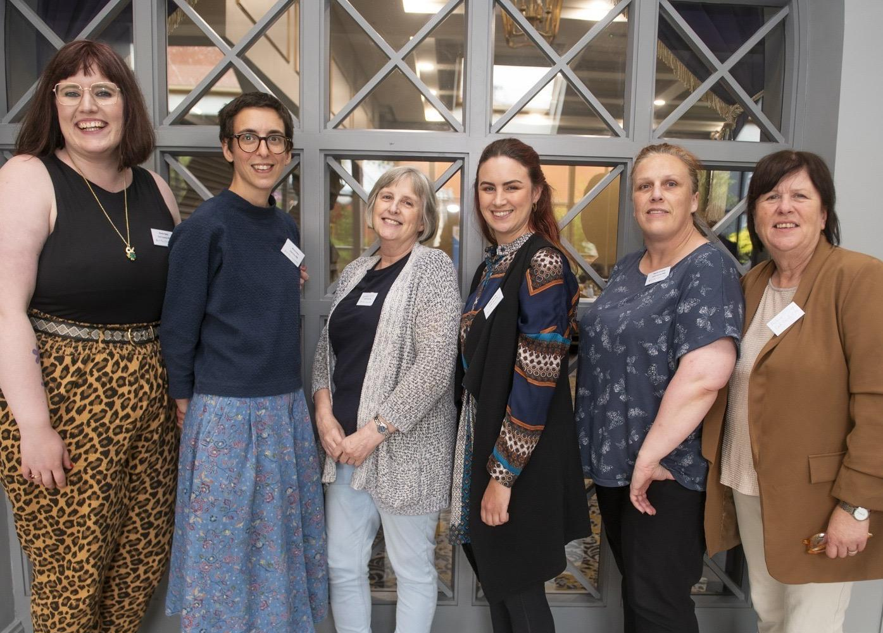
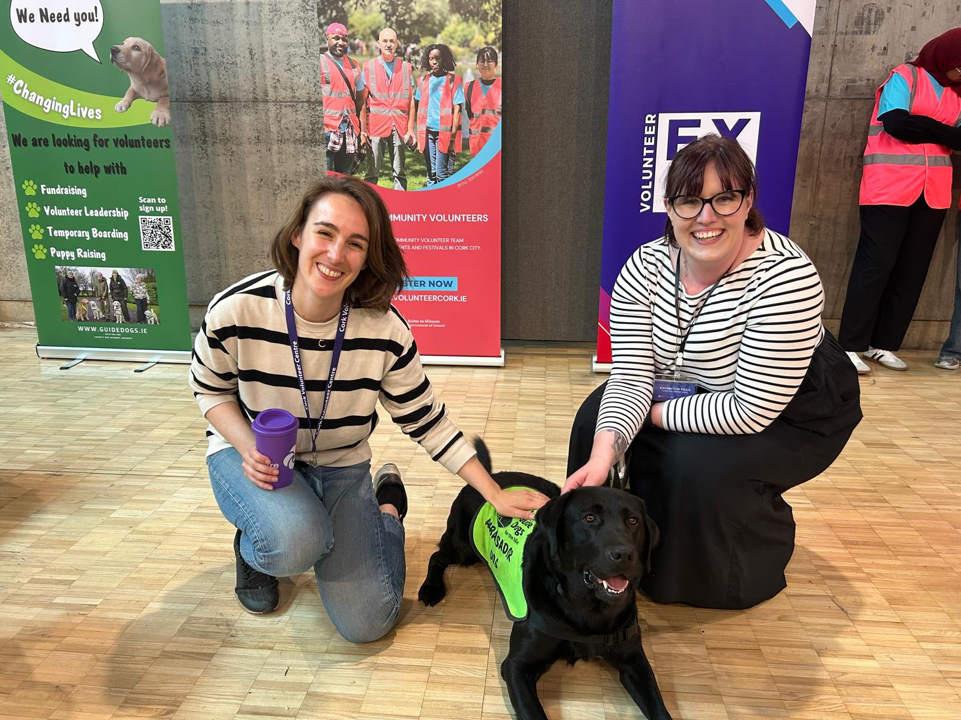

Slide 16
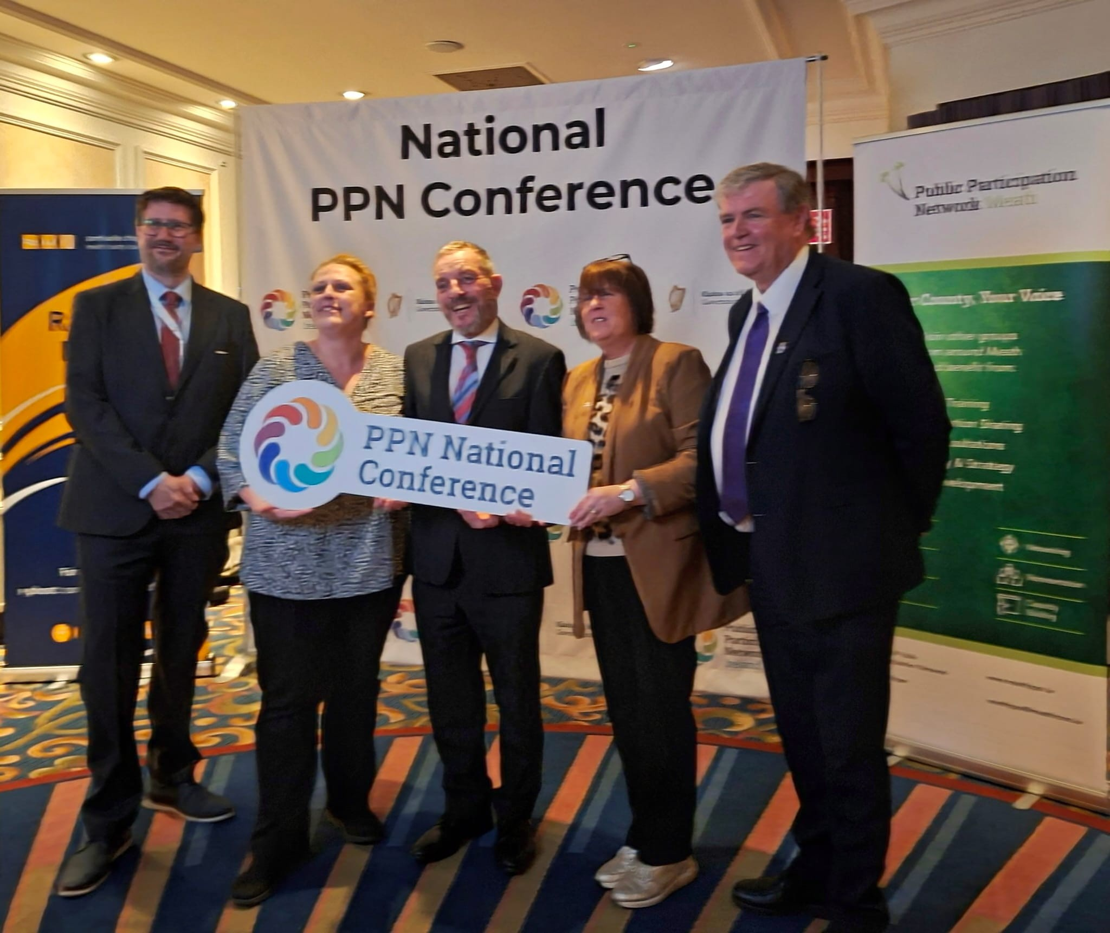
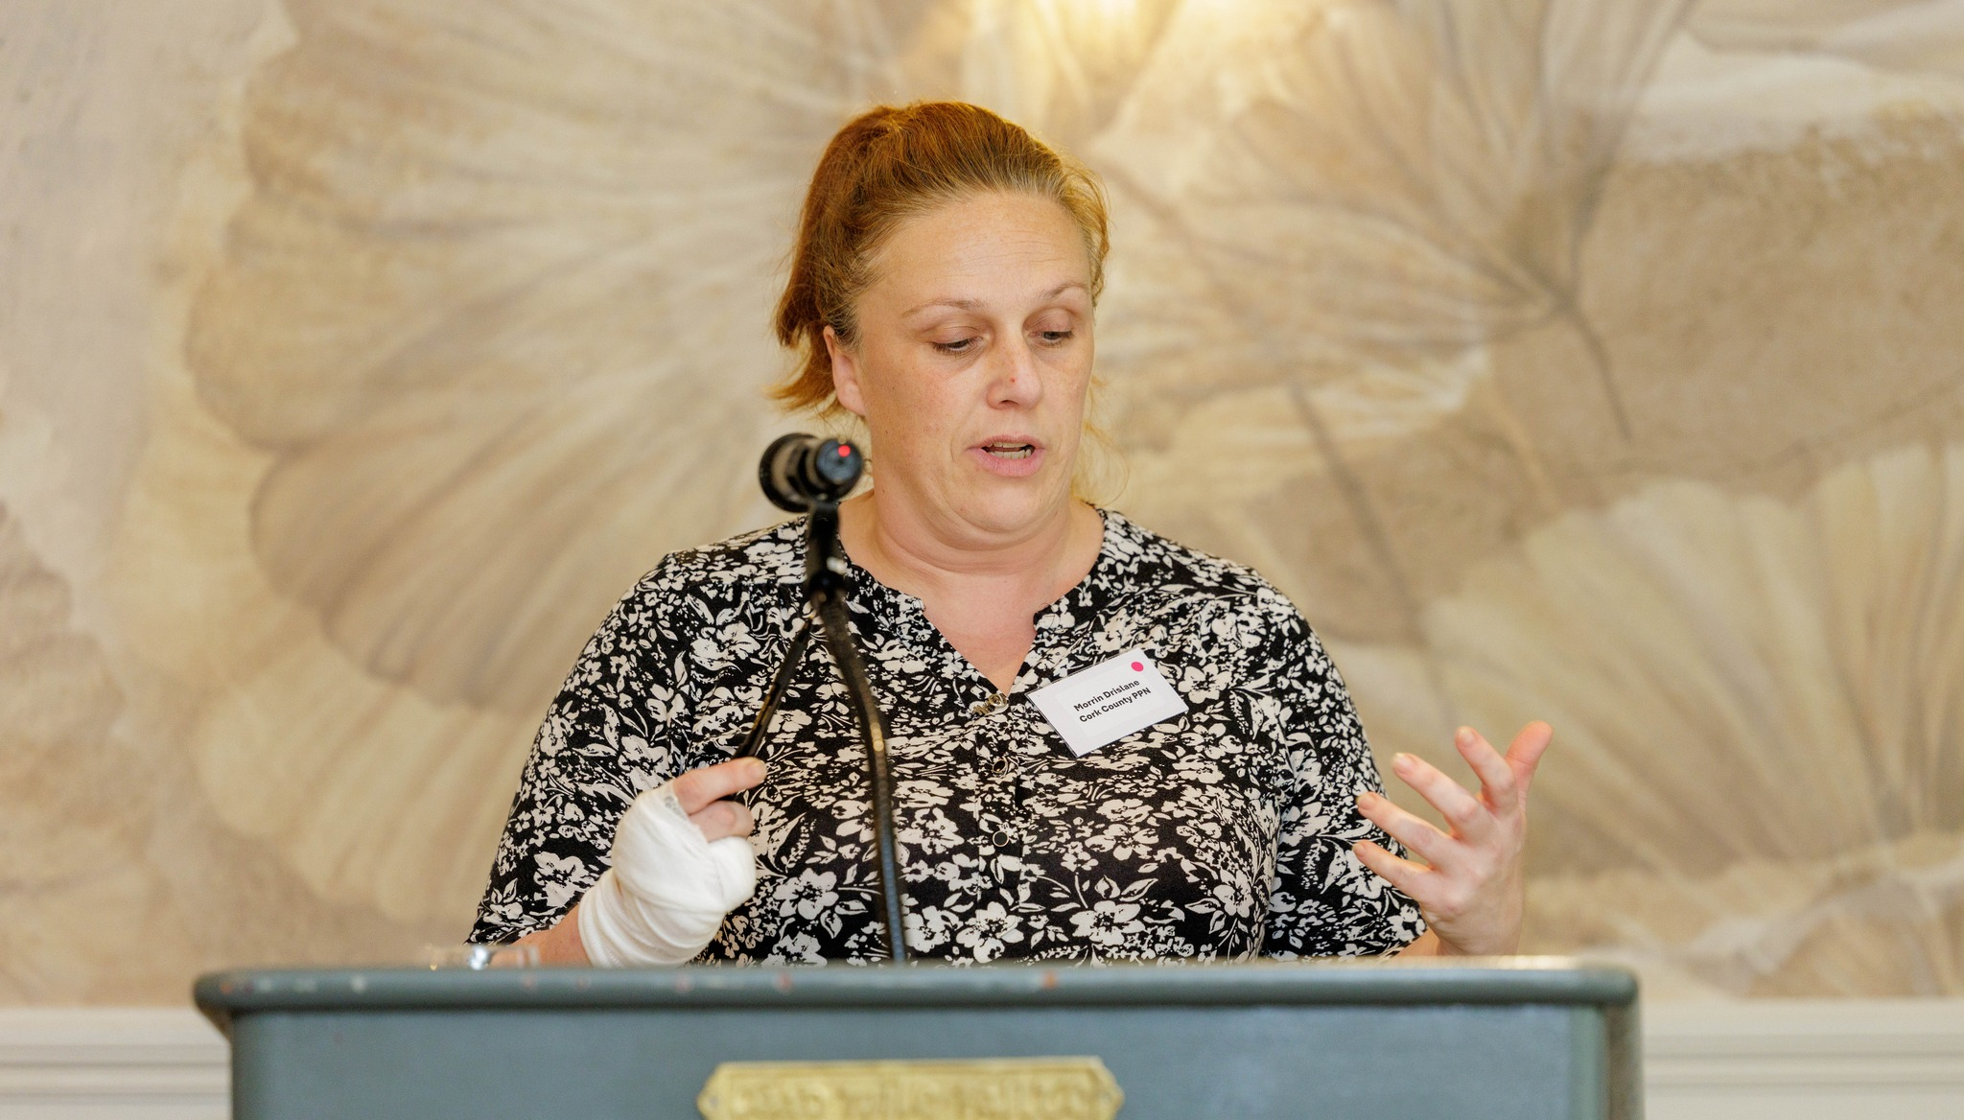


Slide 17
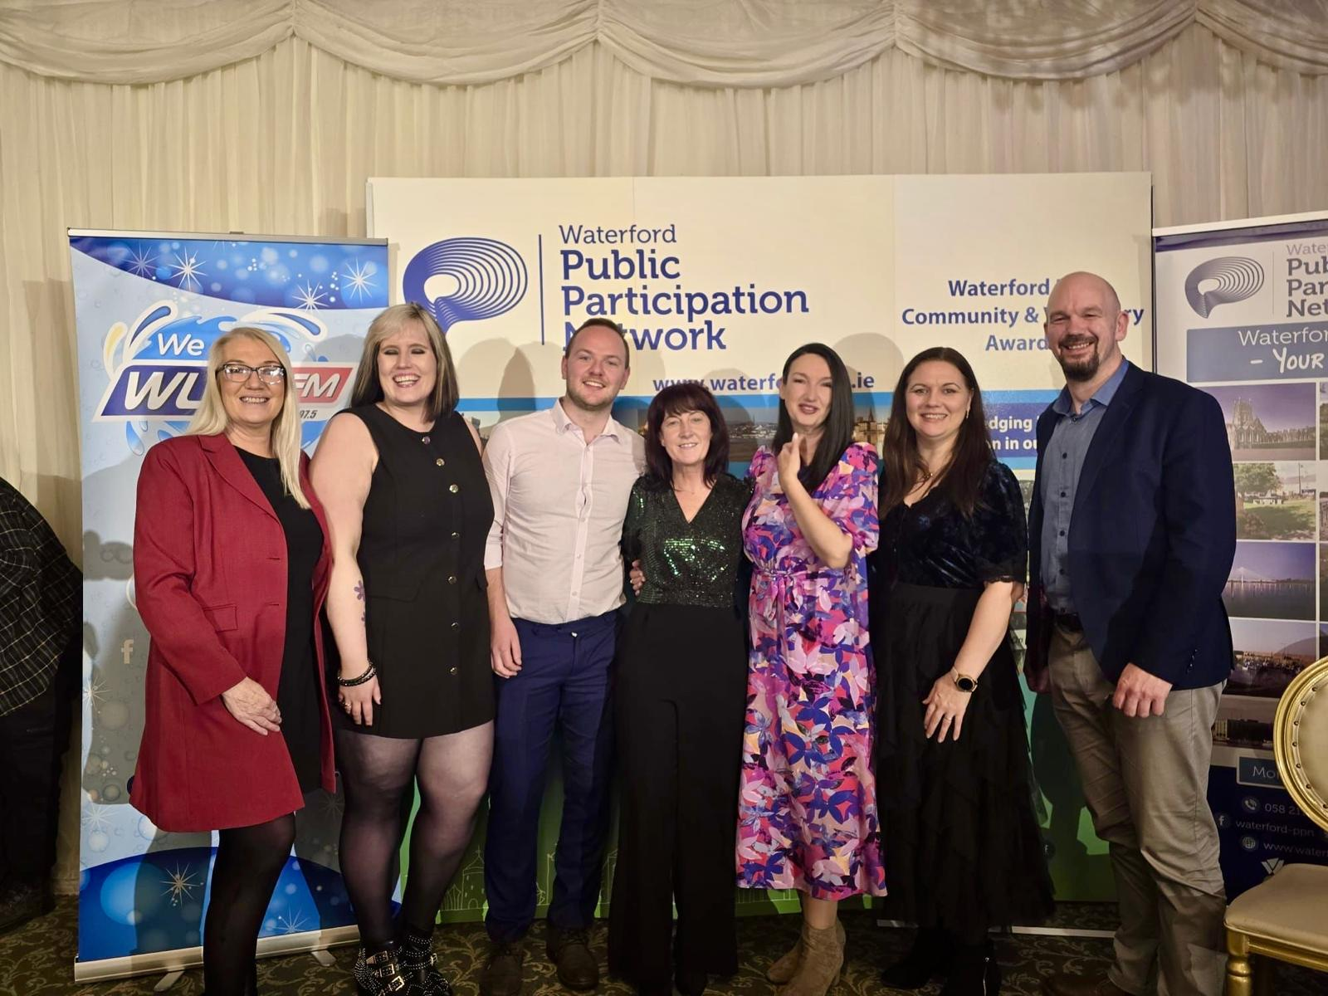
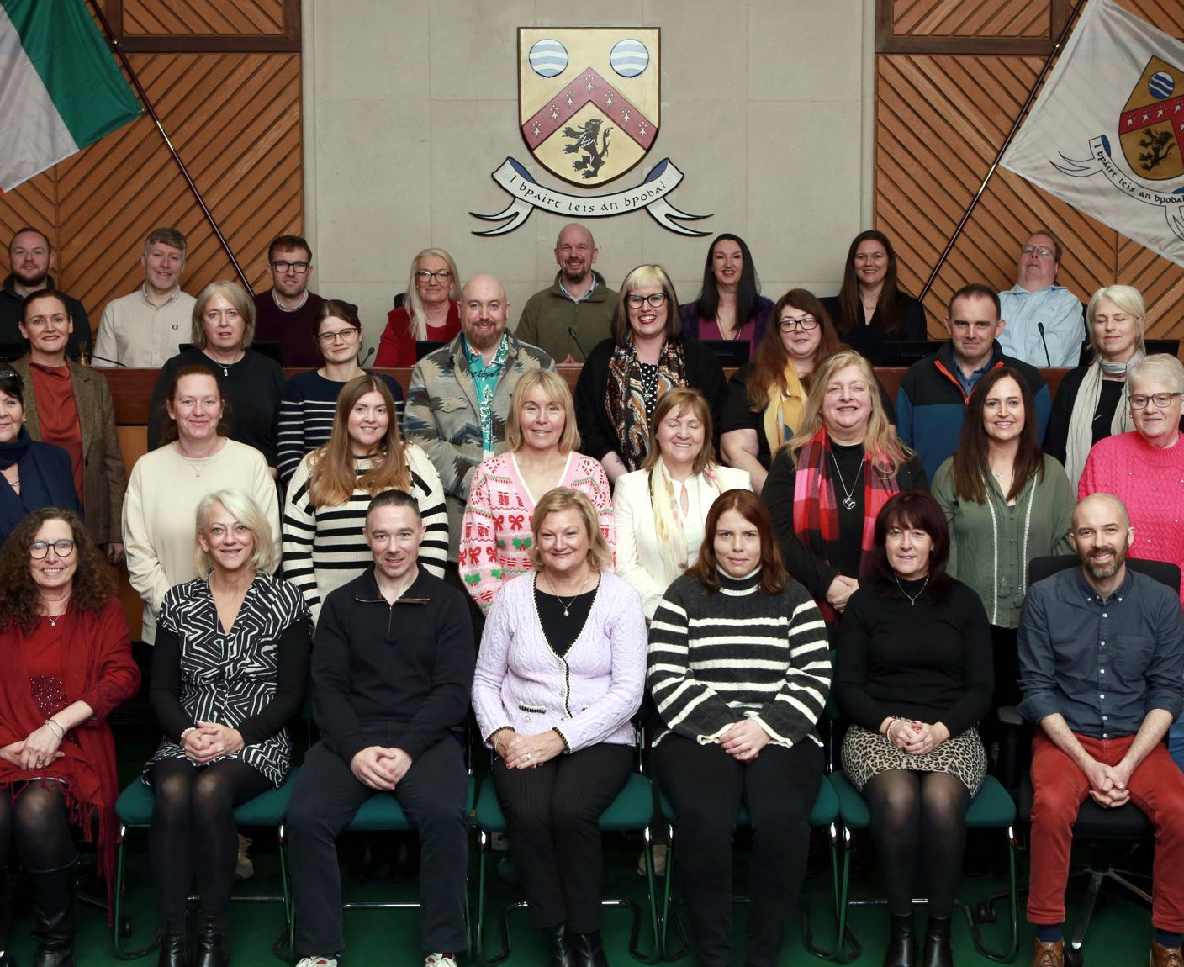
What a busy year!

Slide 18

2025 Financial Report
Financial Report, extension until end of April
€32,687.20 under spend , to be claimed back

Slide 19
2026 Proposed Workplan

Slide 20
Governance & Organisation
Renegotiate and sign MOU with Cork County Council (by March)
Monthly Secretariat meetings (3rd Tuesday each month, 9 meetings in a year)
Sub-groups oversee staff, finance and supports

Slide 21
Representatives & Secretariat
Induction for new representatives and Secretariat members
Training to support meaningful participation
Ongoing support and networking
Need to increase attendance & reporting

Slide 22

Membership & Inclusion
Continue to fill vacancies on committees and Secretariat
Maintain and update member group records, database overhaul
Encourage participation by harder‑to‑reach groups
Encourage stronger engagement by member groups

Slide 23
Communication & Information
Weekly newsletters and regular mass emails
Website and social media kept up to date
Promote funding, supports and member activities

Slide 24
Linkage Groups
Establish and support Linkage Groups
Training and networking opportunities
Improve communication between members and representatives
J Moore, PPN facilitator, recruited last year and has proposed work to get the Linkage Groups up and running

Slide 25

Linkage Group Development Programme Proposal
Linkage Group Development Programme – Cork County PPN
Proposal:
Approve a structured programme to design, establish and support PPN Linkage Groups during 2025–2026, providing a consistent framework for engagement and advocacy.
Timeframe:
Originally scheduled for Q4 2025, with programme delivery in 2026, this has been pushed out.
Scope:
Programme design and rollout
Facilitation of Linkage Groups
Development of shared advocacy outputs

Slide 26

Proposed Work & Deliverables
Key Work Areas:
Deliver a full‑day development workshop for PPN Representatives and Secretariat
Design and agree a Linkage Group framework, including:
Terms of Reference
Work plan and reporting templates
Action tracking and governance supports
Facilitate Linkage Group meetings across key policy themes in 2026
Develop a Cork County PPN Community Issues Paper, building on the existing Wellbeing Statement
Provide feedback and reports to Plenary, Secretariat and members

Slide 27
Key Outcomes & Cost for Approval
Key Outcomes:
More effective and supported representation
Clear, member‑led advocacy priorities
Improved coordination between representatives and member groups
Cost for Approval:
22.5 consultancy days at €625 per day = €14,062.50 (excl. travel & subsistence)

Slide 28
Training & Events
Identify training needs across member groups
Provide relevant, value‑for‑money training
Annual in‑person Christmas event (Nov/Dec)
Events to include IEN Biodiversity Week launch in May, Cork Summer Show, Cork Indian Summerfest, Youghal Credit Union Community Funding event

Slide 29
National & External Engagement
Attend national PPN events and networks
Share learning and feedback with members
Strengthen links across the PPN network
e.g. a presentation to Cork County’s Full Council (we presented to the Social Inclusion SPC last year)

Slide 30
Plenaries, Reporting & Review
Two Plenaries: April (in‑person) and November (online)
Regular reporting to members, Local Authority and DRCDG
Review Workplan in November 2026 and plan ahead together

Slide 31
Comfort Break! Back in 5!

Slide 32
Review of Policies & Procedures 2025

Slide 33

Review of PPN Governance
Dr. Harriet Emerson

Slide 34
Why?
How?
Good practice
Incorporate learning
Refresh awareness
Ensure safe & proper operation
Plenary input
Revision
Secretariat Review
Circulation of Draft
Presentation to Plenary

Slide 35
Structure
Style
Clear
what this policy is for
what & who the policy applies to
Accessible text
Easily understandable language
Clear structure
Downloadable/ online reader
Constitution (& summary)
Supporting governance policies & procedures
Single document AND separately
Internal links
Links to other documents
Web-based (revision)

Slide 36
Changes
Internal inconsistencies
Financial Governance
Conflict of Interest
Grievance procedure (1) – appeals*
Code of Conduct
Financial implications considered
Consistent with PPN Handbook
Consistent with Cork County Council policies (where relevant)*
* Staff are subject to Cork County Council policies
Notes:
Examples
Internal inconsistencies – 4.3.iii The Cork County PPN Reg Form is used to register groups for the purpose of membership of the PPN and for the purposes of accessing supports and funding from Cork County Council p.10
Financial Governance procedures – generated subsequently to last Gov Review – now included. Critical to say who approves expenditure P12, p.70
Conflict of interest – P9, p.59 – entirely NEW policy (not dealt with in Handbook) – relevant for decision making (Secretariat, Reps, etc. & modelling best practice)
Grievance procedure – P8, p.50 – combines 2 previous (Complaints & Grievances) – General approach, Pt I for Staff & Volunteers, Pt II external parties
Code of Conduct – P5, p.36 link to Vulnerable Adults & Equality & Diversity policy as well as Comms policy
Financial implications – checked e.g. removal of reference to a Linkage Group Fund for specific action-based projects, or Equality & Diversity Policy previously referred to counselling being available to parties at any stage. Not within PPN budget AND compliance with Charities Governance Code
Consistent with PPN Handbook – Requirement to check this again, when new Handbook is published (currently under review)
Consistent with Cork Co. Council policies – as PPN host organisation, Constitution 5.3.viii looks for consistency with GDPR policy and Council policies to ensure same, OR Grievance Procedure P8, 2 on p. 50 –is intended to be consistent with and may not contravene or override Council policies

Slide 37
Knowing & Using PPN Governance
Aim is to support work of the PPN
Awareness is important – but nobody’s holiday reading!
Day-to-Day use => familiar & shows up shortcomings
Effort to be inclusive –workshop
Questions?

Slide 38
PPN Rep Vacancies:

Slide 39
Strategic Policy Committee Vacancies:
Economic Development & Enterprise SPC – 2 vacant seats
Tourism SPC – 1 vacant seat
Social Inclusion, Community & Rural Development SPC – 2 vacant seats
Arts, Culture & Language SPC – 1 vacant seat

Slide 40
Local Community Development Committee Vacancies:
North Cork – 2 Social Inclusion Vacancies
South Cork – 1 Social Inclusion Vacancy
West Cork – 1 Social Inclusion Vacancy

Slide 41
Secretariat Vacancies:
2 x Vacant seats – Carrigaline Municipal District
Vacant seat – East Cork Municipal District
Vacant seat – Kanturk/Mallow Municipal District
Vacant seat – Macroom Municipal District
2 x Vacant seats – Environmental Electoral College

Slide 42
AOB / Closing Remarks

